Slide 1
Project Management
Prof. Dr. Dirk Riehle
Friedrich-Alexander University Erlangen-Nürnberg
AMOS B02
Licensed under CC BY 4.0 International

Slide 2
Project Management
The AMOS Project directive is simplify, simplify, simplify!
  One tool for product and process management (Google Sheets)
  Other tools for software development (GitHub, Travis-CI, etc.)
  Teams may add additional tools at their discretion (and own risk)
Project management in The AMOS Project includes
  Product management (product owner role)
  Development task allocation (software developer role)
  Release management (review and release manager role)
  Process improvement (Scrum master role)
Project management is performed using Google Sheets
  Planning documents template: http://goo.gl/Brc0Q
  Example artifacts: http://goo.gl/FRfym
Please share your copy with team coach

Slide 3
Planning Document Tabs
# | Category | Artifact Name | Artifact Purpose
1 | General | Project Data | Collects basic project data
2 | General | Project Team | Shows project team and static roles
3 | General | Role Assignments | Tracks dynamic role assignment
4 | Product | Product Vision | Provides product and project vision
5 | Product | Product Glossary | Provides core terminology of project
6 | Project | Release Plan | Provides mid-term and final release plan
7 | Project | Burn-down Chart | Provides Scrum burn-down chart
8 | Project | Development Speed | Provides Scrum development speed chart
9 | Product | Product Backlog | Shows open functionality, prioritized
10 | Project | Sprint Backlog | Shows current work backlog
11 | Product | Feature Archive | Collects finished functionality
12 | Process | Impediments Backlog | Tracks process problems and solutions
13 | Process | Definition-of-Done | Provides decision criteria for “done”
14 | Product | Documentation | Provides additional documentation of product
15 | Product | Bill-of-materials | Lists all third-party components
16 | ... | ... | ...

Slide 4
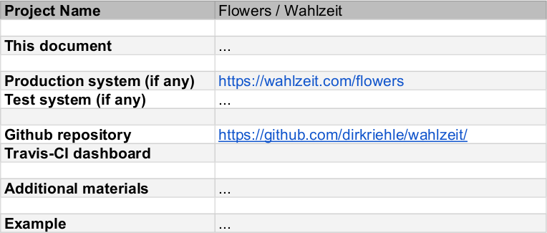
1. General: Project Data 1 / 2

Slide 5
1. General: Project Data 2 / 2
Definition
  A collection of relevant (starting point) links
Purpose
  Simplify navigation
Production and system
  Deployment scenarios depend on project but please try hard
Github repository
  Required
CI dashboard
  Optional

Slide 6
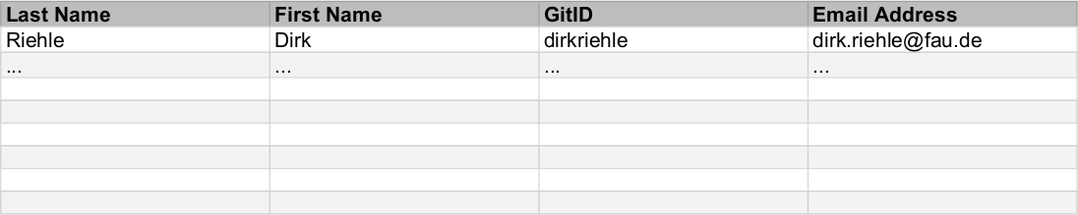
2. General: Project Team 1 / 2

Slide 7
2. General: Project Team 2 / 2
Definition
  The list of team members and their contact information
Purpose
  Make it easy to contact inviduals or the whole team
Pragmatics
  Feel free to adjust with other information, e.g. Skype ID

Slide 8
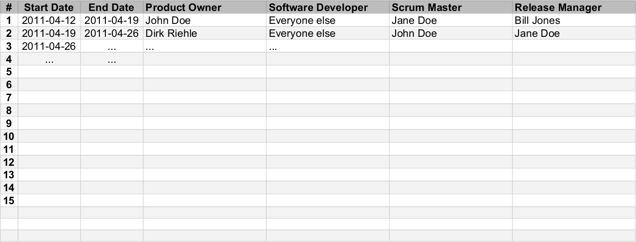
3. General: Role Assignments 1 / 2

Slide 9
3. General: Role Assignments 2 / 2
Definition
  A week-by-week assignment of roles to team members
Purpose
  Provide plan and history of role assignments so everyone knows their job
Pragmatics
  Please plan out the project at start of course
  Feel free to add roles beyond the four required ones
Use the same week numbers as in the Course schedule
  Week 1 starts with the first lecture
  Week 1 also starts the first sprint

Slide 10
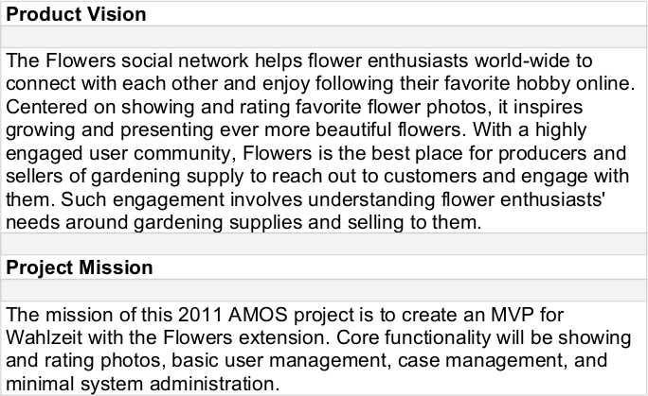
4. Product: Vision and Mission 1 / 2

Slide 11
4. Product: Vision and Mission 2 / 2
Definition of product vision
  A product vision communicates
    The main purpose and core functionality of the product
    The value the main stakeholders receive
    It is inspiring, timeless, focused and the final arbiter
Definition of project mission
  A project mission summarizes
    What the project wants to achieve
    Within the project time-frame
Purpose
  Explain project succinctly
  Serve as a guiding star when prioritizing features
Pragmatics
  Product vision and project mission should be short

Slide 12
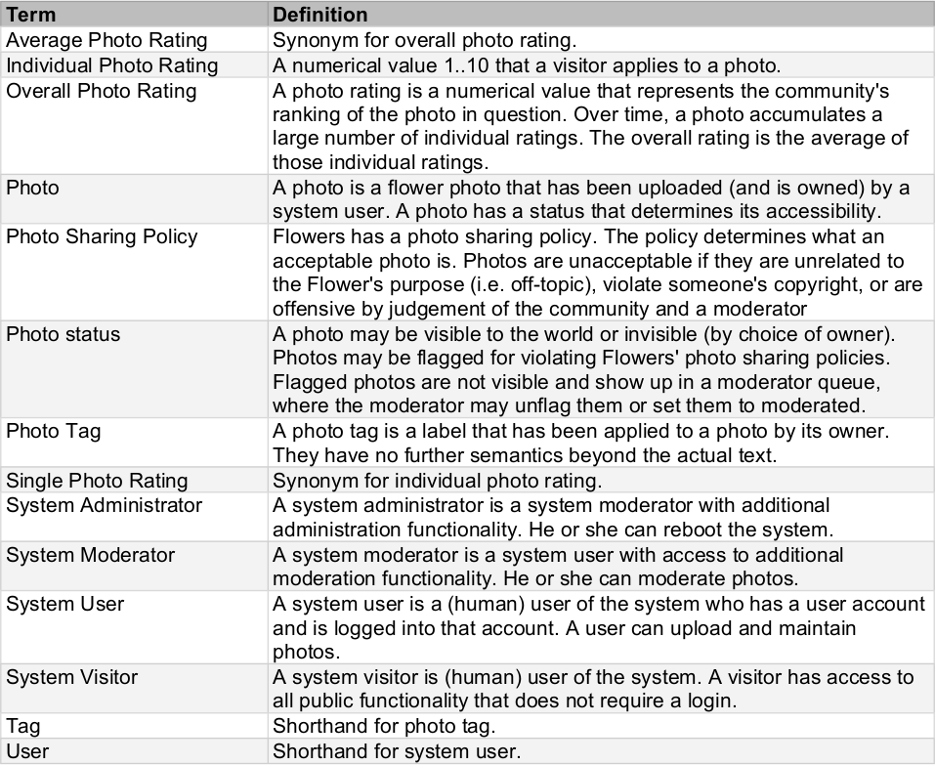
5. Product: Glossary 1 / 2

Slide 13
5. Product: Glossary 2 / 2
Definition
  Is an alphabetically ordered list of terms and their definition
Purpose
  Provide key domain terminology (shared vocabulary) of project
  Is a simplified form of a domain model accessible to everyone
Term
  A (possibly qualified) noun determining the concept to be defined
Term definition
  The definition of the referenced term
  A base definition is a declarative statement of the form X is a X*
  Other forms of definitions are synonyms, shorthands, etc.

Slide 14
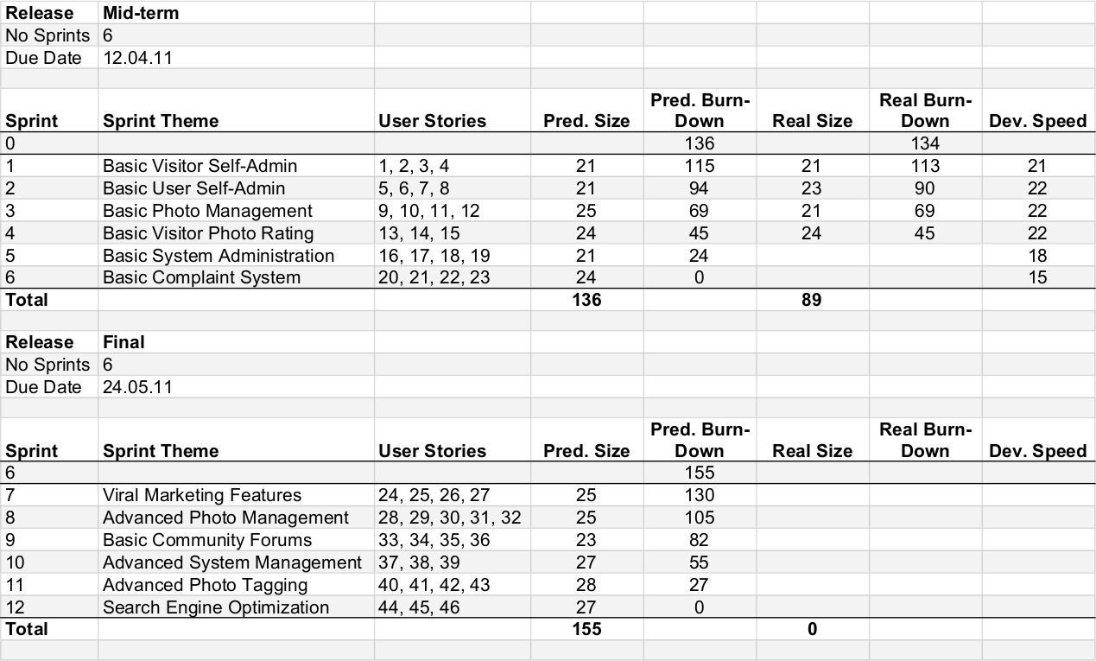
6. Product: Release Plan 1 / 2

Slide 15
6. Product: Release Plan 2 / 2
Definition
  A prioritized list of features for a product release
Purpose
  To predict the content of the upcoming product release
Pragmatics
  Has been estimated by developers, validated by historic data
  Is a living document, that is, gets adjusted after each sprint

Slide 16
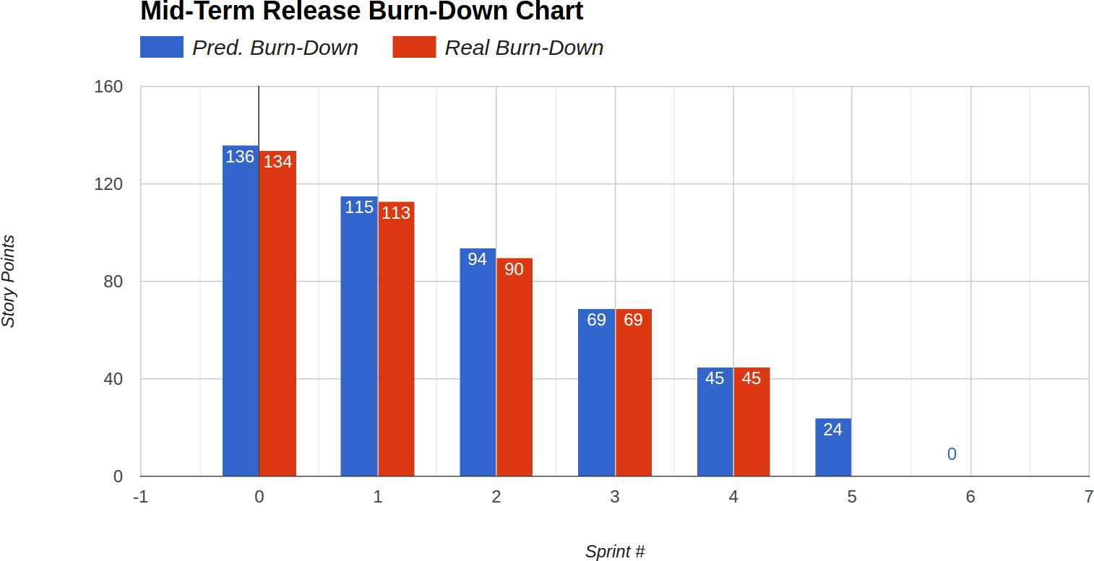
7. Product: Burn-down Chart 1 / 2

Slide 17
7. Product: Burn-down Chart 2 / 2
Definition
  A visualization of the progress towards the next product release
  Contrasts actual progress with originally estimated progress
Purpose
  Make visible what cannot be easily seen in the product release plan

Slide 18
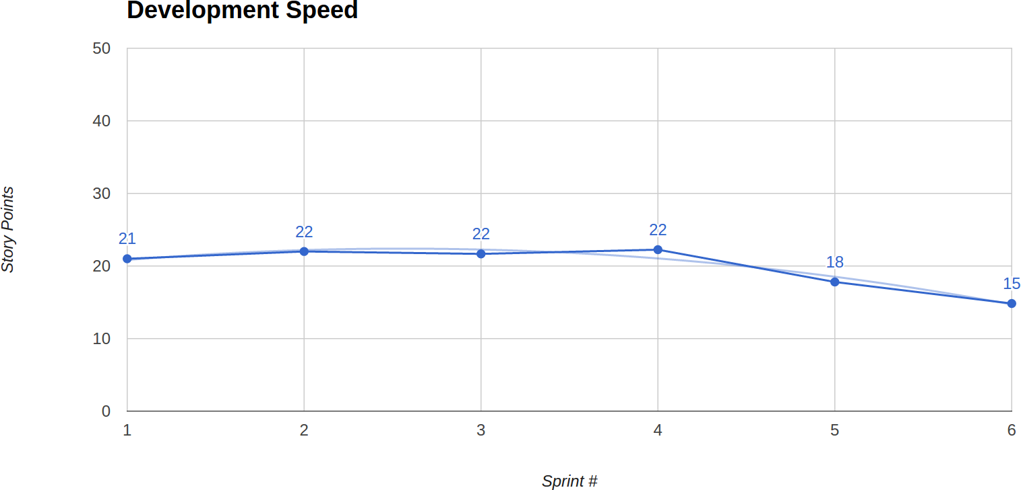
8. Product: Development Speed Chart 1 / 2

Slide 19
8. Product: Development Speed Chart 2 / 2
Definition
  A visualization of the develop development speed of the development team

Slide 20
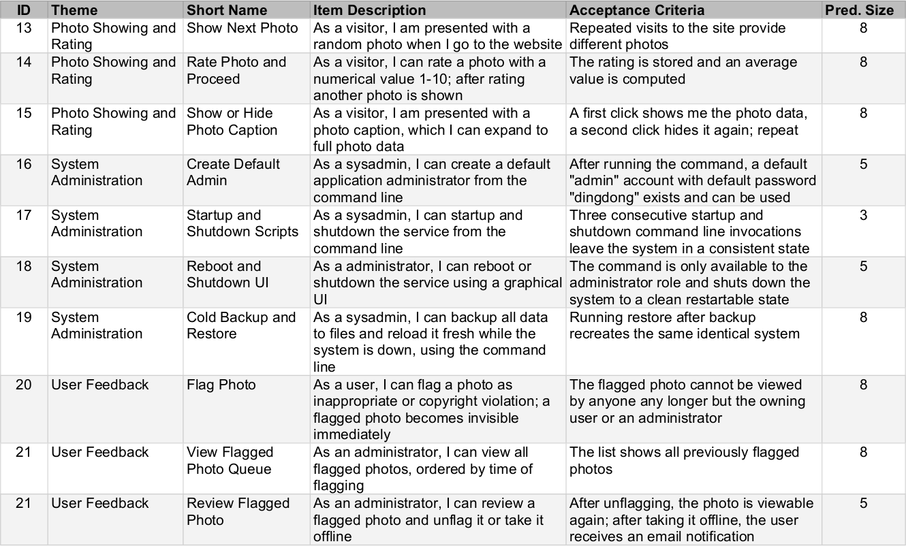
9. Product: Product Backlog 1 / 2

Slide 21
9. Product: Product Backlog 2 / 2
Definition
  A prioritized list of needed features, bugs-to-fix, and refactorings
  Features are created by POs, bugs derive from Github issues
Purpose
  To know at any time what will come up next
  To serve as a living document for the PO for requirements
Pragmatics
  The higher the priority of a backlog entry, the closer to the top
  Priorities are defined by order in backlog, not broad categories
  All high-priority backlog entry provide initial guess on size
  Highest priority backlog entries should be specified well
  Further down the backlog, entries can be more vaguely defined

Slide 22
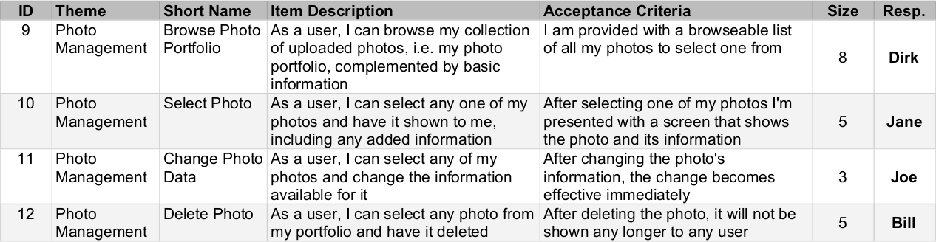
10. Product: Sprint Backlog 1 / 2

Slide 23
10. Product: Sprint Backlog 2 / 2
Definition
  The current sprint’s workload as committed to by team
Purpose
  To know at any time what to do in the current sprint
  To serve for task allocation between developers
Pragmatics
  Sprint backlog entries are copied over from product backlog
  Every sprint backlog entry comes with an estimated size
  After successful implementation, they move to feature archive

Slide 24
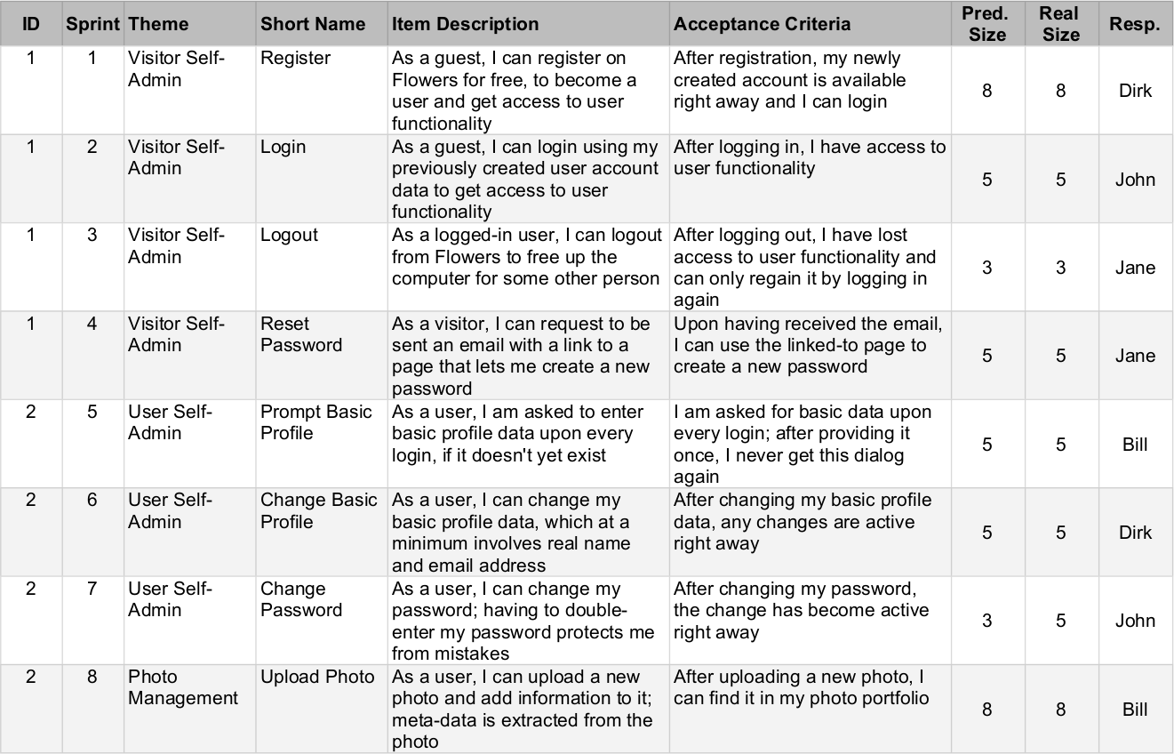
11. Product: Feature Archive 1 / 2

Slide 25
11. Product: Feature Archive 2 / 2
Definition
  A list of features that have been implemented
  All features contain the original size estimation
  All features contain an after-the-fact size estimation
Purpose
  To serve as a (most basic) list of product functionalities
  To allow lookup of history of development

Slide 26
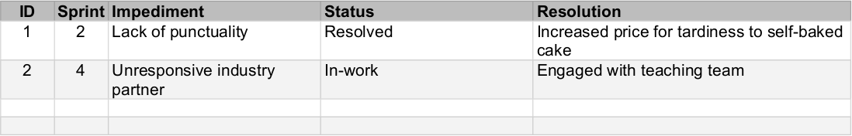
12. Process: Impediments Backlog 1 / 2

Slide 27
12. Process: Impediments Backlog 2 / 2
Definition
  A list of current and historic impediments to process
Purpose
  To know at any time the current impediments
  To see whether any impediments keep recurring
Pragmatics
  It names the Scrum master responsible for resolution
  It provides the solution found, if any

Slide 28
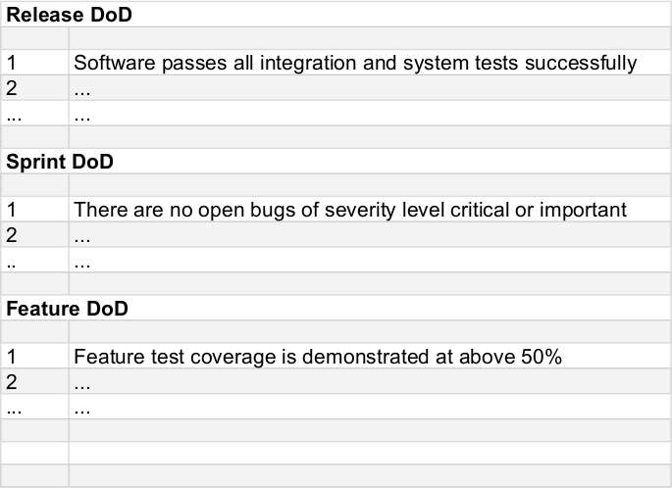
13. Process: Definition-of-Done 1 / 2

Slide 29
13. Process: Definition-of-Done 2 / 2
Definition
  Is a check list of decision criteria to determine status of “done”
Purpose
  To be consistent about what “done” means
Pragmatics
  Definitions of “done” (DoD) require team consensus
  There are many such decisions, hence many DoDs needed
  At a minimum, at the proper time, the team should have a
    DoD for sprint release
    DoD for product release

Slide 30
14. Product: Documentation 1 / 2

Slide 31
14. Product: Documentation 2 / 2
Definition
  The product documentation (where to find what)

Slide 32
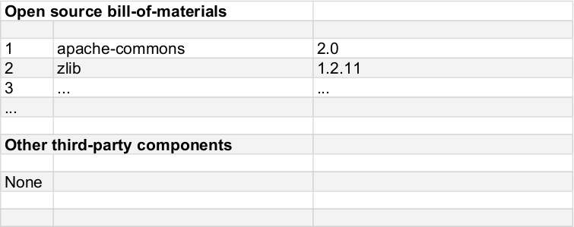
15. Product: Bill-of-Materials 1 / 2

Slide 33
15. Product: Bill-of-Materials 2 / 2
Definition
  A list items (“materials”) included in the project
    Items typically mean open source libaries
Purpose
  To maintain an overview of “what’s the box”
Pragmatics
  Please lists all third-party components used by the product
  List only those used directly; no need to recursively unpack
  In case of open source components, also list their license

Slide 34
Thank you! Questions?
dirk.riehle@fau.de – http://osr.cs.fau.de
dirk@riehle.org – http://dirkriehle.com – @dirkriehle
DR

Slide 35
Credits and License
Original version
  © 2012-2020 Dirk Riehle, some rights reserved
  Licensed under Creative Commons Attribution 4.0 International License
Contributions
  ...

